Slide 1


KJEI’s
K J College of Engineering & Management Research,
Pune
DEPARTMENT OF COMPUTER ENGINEERING
Year: 2022-2023
Motion Detection & Multiple Face Identification using Webcam
Guide by | Group Members
Prof. Rohini V. Agawane | Varad Kalkhaire
 | Ashutosh Khatavkar
 | Shubham Dhanne
 | Shantanu Bhumkar

Slide 2
Table of content
1
Introduction
2
Motivation
3
Literature Study
4
Software & Hardware Requirements
Proposed System
5
6
Modules
Activity Diagram
7
Result
8
9
Test Cases
10
Conclusion
Future Scope
11
References
12

Slide 3
Introduction
As technology is marking the highest peak in this modern world, all things are being automated using machine learning and deep learning. By using machine learning models, we can detect the movements, action, multiple faces, their recognition and many more in just A second of time.
The title “Motion Detection and Multiple Faces Identification using Webcam” tells us much more about this system. The “Motion Detection” were the actions made by an object is going to be observed. And the “Multiple Faces Identification” were detection and recognition of multiple faces is done at same time. Both model use webcam / security camera for detecting motion and multiple faces in single video frame, and A database is used to recognize multiple faces and storing of newly detected face.

Slide 4
motivation
Motion detection and multiple faces identification technologies offer numerous benefits, ranging from enhanced security and efficiency to personalized experiences and improved safety in various domains. By harnessing their potential, we can create smarter, safer, and more engaging environments like:
Enhanced Security: Motion detection and multiple faces identification technologies contribute significantly to enhancing security systems. By accurately detecting motion and identifying multiple faces, these technologies can help prevent unauthorized access, intrusions, and potential threats.
Crime Prevention: The implementation of motion detection and multiple faces identification can deter criminal activities. With advanced systems in place, potential criminals are more likely to be identified and caught, reducing the overall crime rate.
Efficient Surveillance: Motion detection allows surveillance systems to focus on relevant areas only when there is activity, minimizing unnecessary recordings and saving storage space. Combined with multiple faces identification, these technologies enable efficient monitoring of public spaces, ensuring public safety and quick response to any incidents.

Slide 5
Literature survey
Sr. No | Publication | Author Name | Paper Name | Year | Discretion
1. | International Journal of Scientific Research in Science, Engineering and Technology(IJSRSET) | Shubham Mishra, Mrs Versha Verma, Dr. Nikhat Akhtar, Shivam Chaturvedi, Dr. Yusuf Perwej, | An Intelligent Motion Detection Using OpenCV | 2022 | A computer vision system's basic goal is to detect moving things. For many applications, the performance of these systems is insufficient. One of the key reasons is that dealing with numerous restrictions such as environmental fluctuations makes the moving object detection process harder.
2. | Institute of Electrical and Electronic Engineers(IEEE) | Maliha Khan, Sudeshna Chakraborty, Rani Astya, Shaveta Khepra | Face Detection and recognition using opencv | 2019 | Face detection and picture or video recognition is a popular subject of research on biometrics. Face recognition in a real-time setting has an exciting area and a rapidly growing challenge. Framework for the use of face recognition application authentication. This proposes the PCA (Principal Component Analysis) facial recognition system.
3. | Research Journal of Engineering and Technology | Pooja Nagpal, Shalini Bhaskar Bajaj, Aman Jatain, Sarika Chaudhary, | Motion Detection of Webcam Using Frame Differencing Method, | 2021 | It is the capability of humans and as well as vehicles to automatically detect object level motion that results into collision less navigation and also provides sense of situation. This paper presents a technique for secure object level motion detection which yields more accurate results.

Slide 6
Software and hardware requirement
Software requirements:
Python
MySQL
Hardware requirements:
Operating system: Windows 10 (and above) or Linux
Processor: Intel i3/i5/i7 or AMD Ryzen
Speed: 3.10 GHz and above
RAM: 8gb(min) up to 16GB (max)
Storage:500 GB(SSD)
Peripherals: Keyboard, Mouse,Webcam

Slide 7
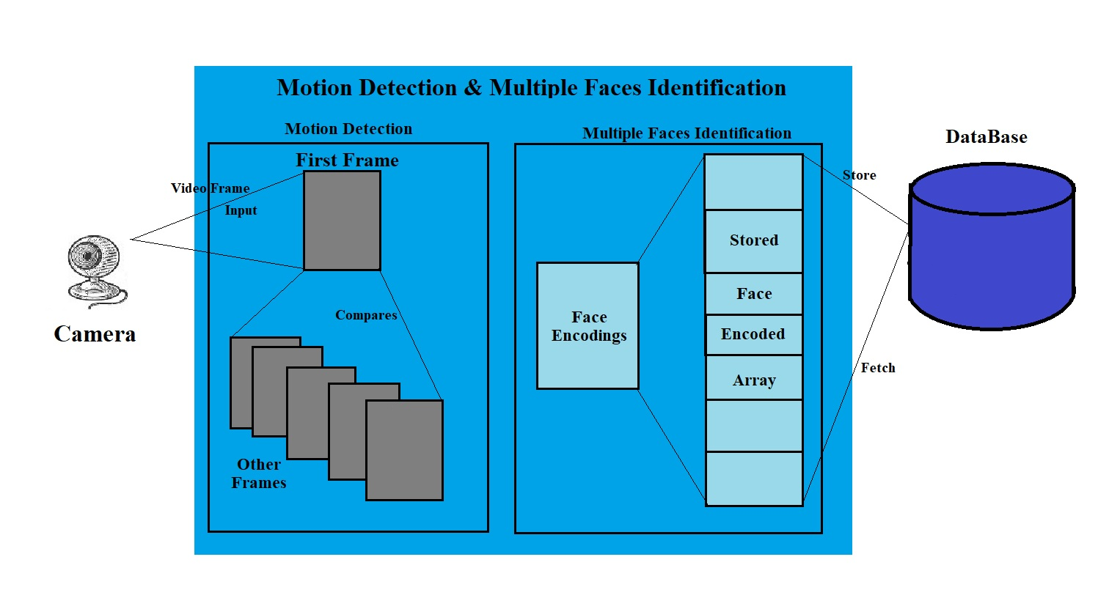
Proposed System
Fig. Architecture Diagram

Slide 8
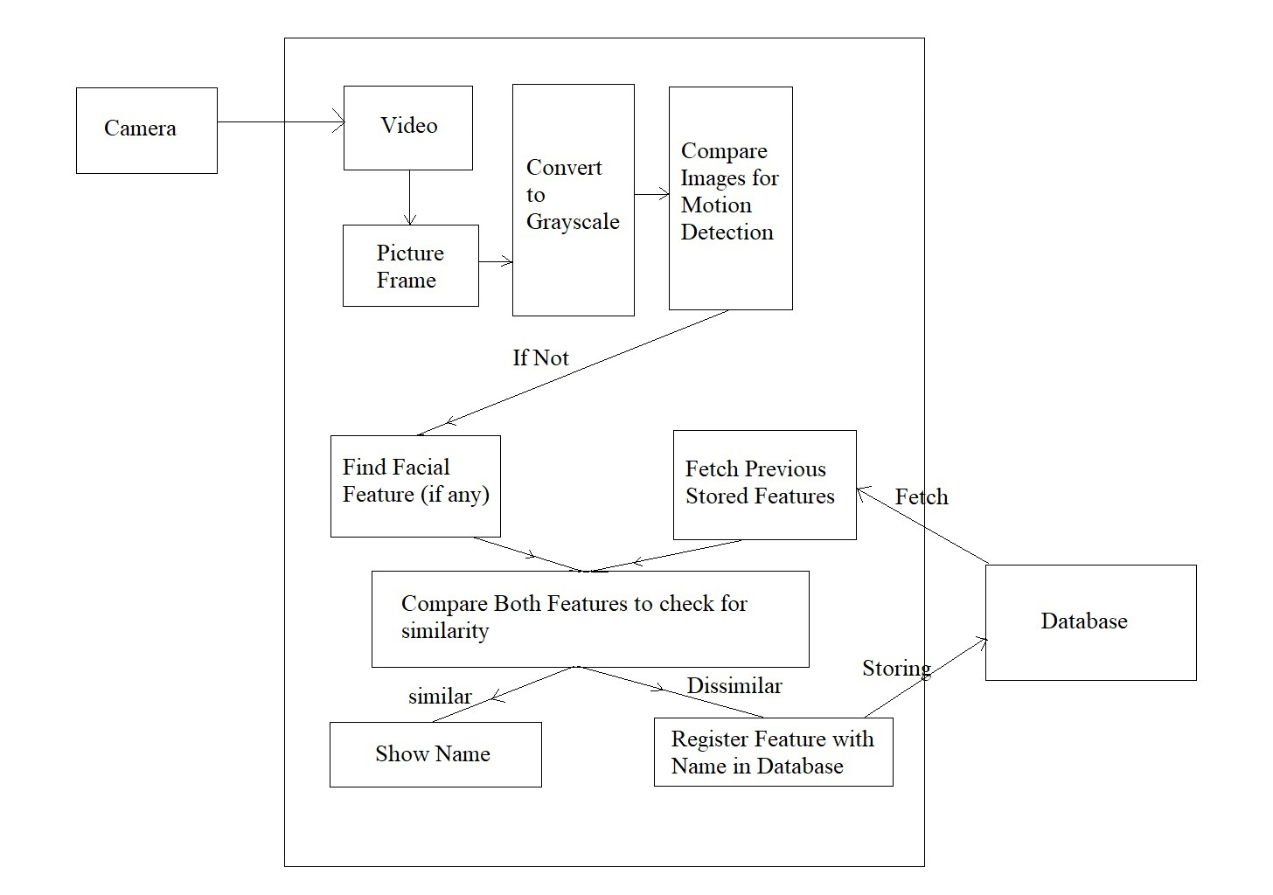
Proposed System (cont.)
Fig. Block Diagram

Slide 9
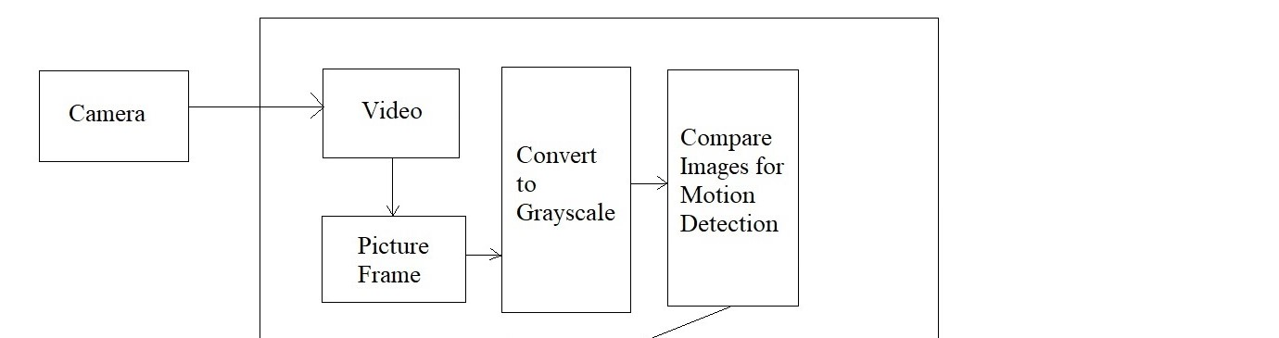
Modules: Motion Detection
The motion detection module uses live video stream from Webcam and Gaussian-Blur method to detect the motion.
For detecting the motion in a live video camera, the Gaussian-Blur method uses frames of video captured by Webcam. These frames are then converted into grey scale image frames from RGB color image.
These grey scale images are nothing but 0 or 1 i.e., in the binary value and helps to detect the motion. The Gaussian-Blur method compares the first frame with other frames using a threshold called contour.
By minimizing the threshold value, we can detect small motions made by an object and by maximizing it, we can detect motions which moves from one place to another within video frame of Webcam.

Slide 10
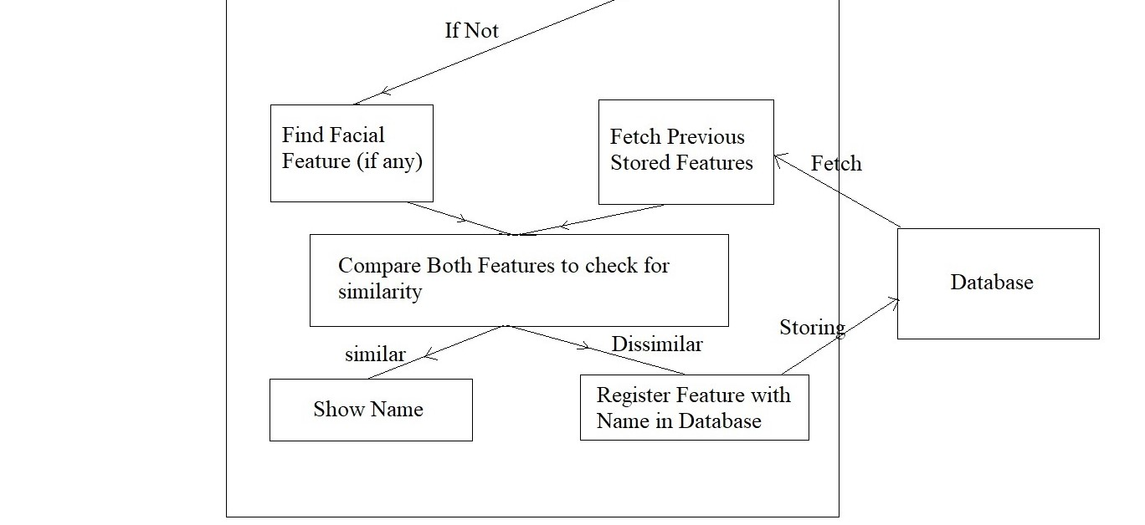
Modules: Face Identification
For detection of multiple faces, the Haar-Cascade Classifier model is used. The faces are detected using gray scale image, which helps to detect faces quickly.
By using the Haar-Cascade Classifier model we can detect multiple faces and store newly detected face in the database and also in the local storage.
Also, these detected face encodings are send toward recognition model for face recognition of known faces.
The Face Recognition model is used to recognize the face by taking current face encodings and past stored encodings in database.
The past stored encodings are stored in MySQL database and fetched when we need to recognize the faces.
The Face Recognition module, compare the current face encodings with the previously stored encodings in the database.

Slide 11
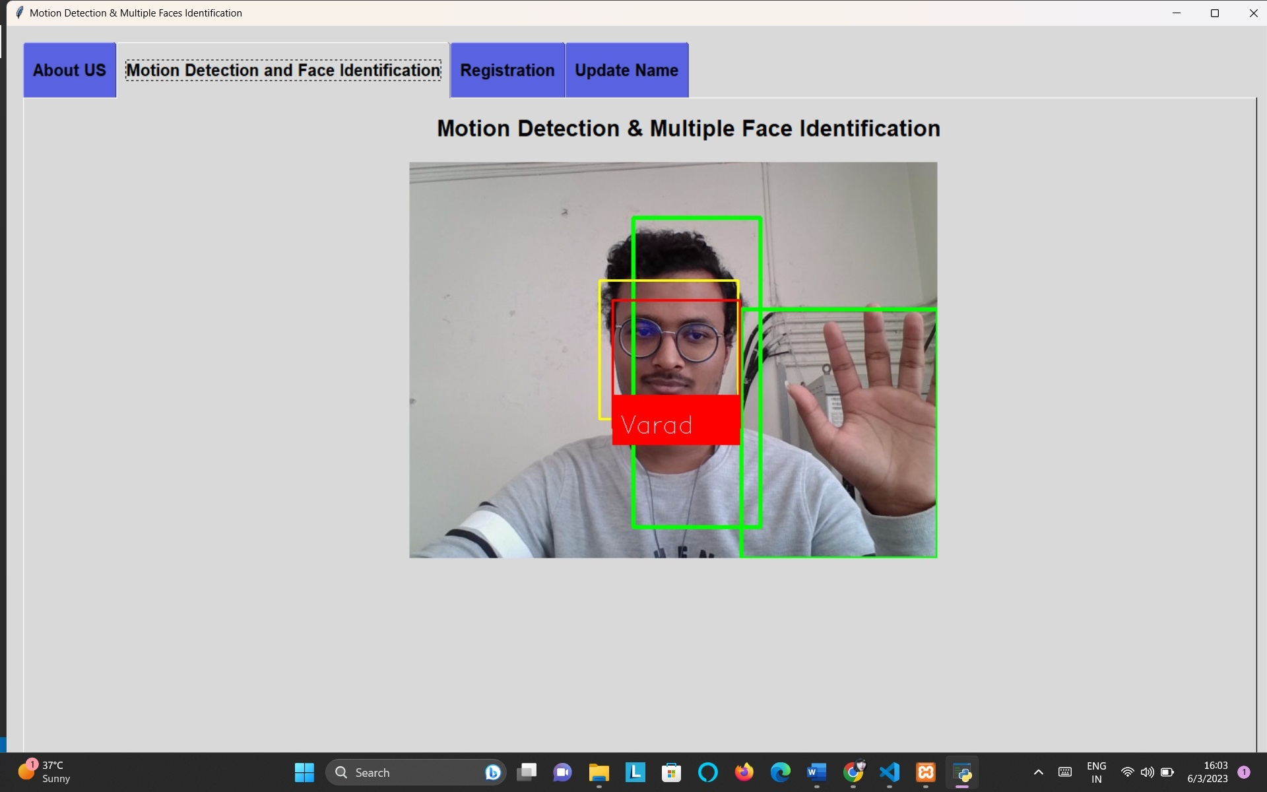
Result
The whole model executes simultaneously i.e., at first the motion detection module executes to detect motion, if there is no motion detected by model then Face Identification module executes to detect multiple faces and recognize the faces using previously stored data in database.
The model uses Webcam as Surveillance Camera to provide advanced security and use machine learning and deep learning models to automate the motion detection and multiple faces identification.
This whole project is in loop to work more efficiently and give continuous output as shown in Figure aside.

Slide 12
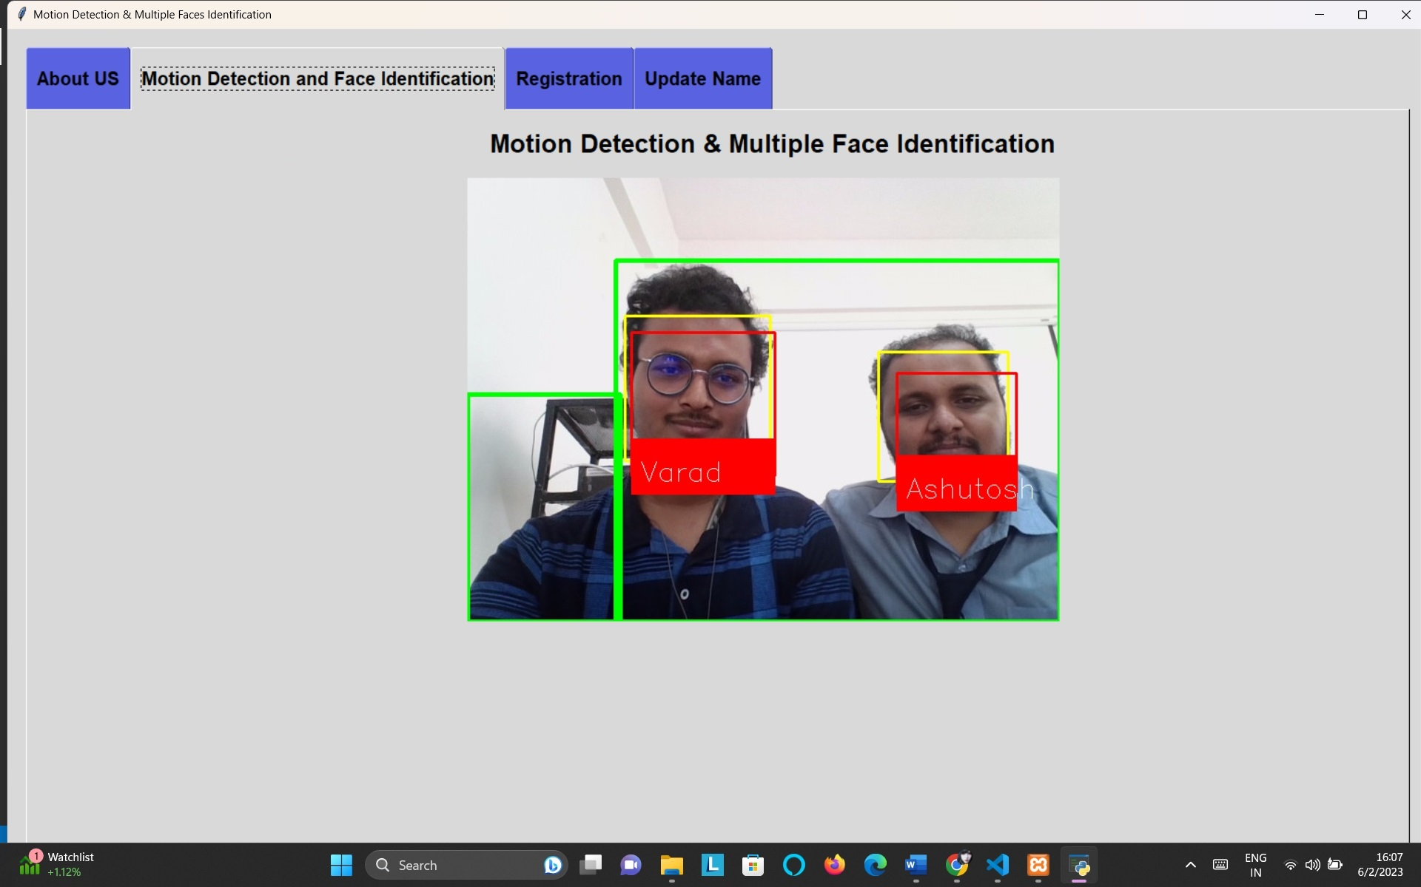
Result (Cont.)
In the Figure aside, the Green Boxes in the result shows how the use of Gaussian-Blur model helps the motion detection model to execute efficiently and find the even the smallest movements or actions made by human or an object. Gaussian-Blur makes the motion detection model faster by using grey scale image processing.
The Yellow boxes in the result shows the execution output of multiple face detection. By using Haar-Cascade Classifier model, it is quite easy to detect multiple faces at the same time without taking more execution time.

Slide 13
Result (cont.)
Also, the Red Boxes in result shows, how efficiently and effectively the model recognizes multiple faces by fetching their names from the database without getting any error and reducing the execution time. The Face Recognition module helps to recognize the human faces using the Webcam rather than the Sensors. It uses the Face Recognition Module which helps to recognize the faces in better way.

Slide 14
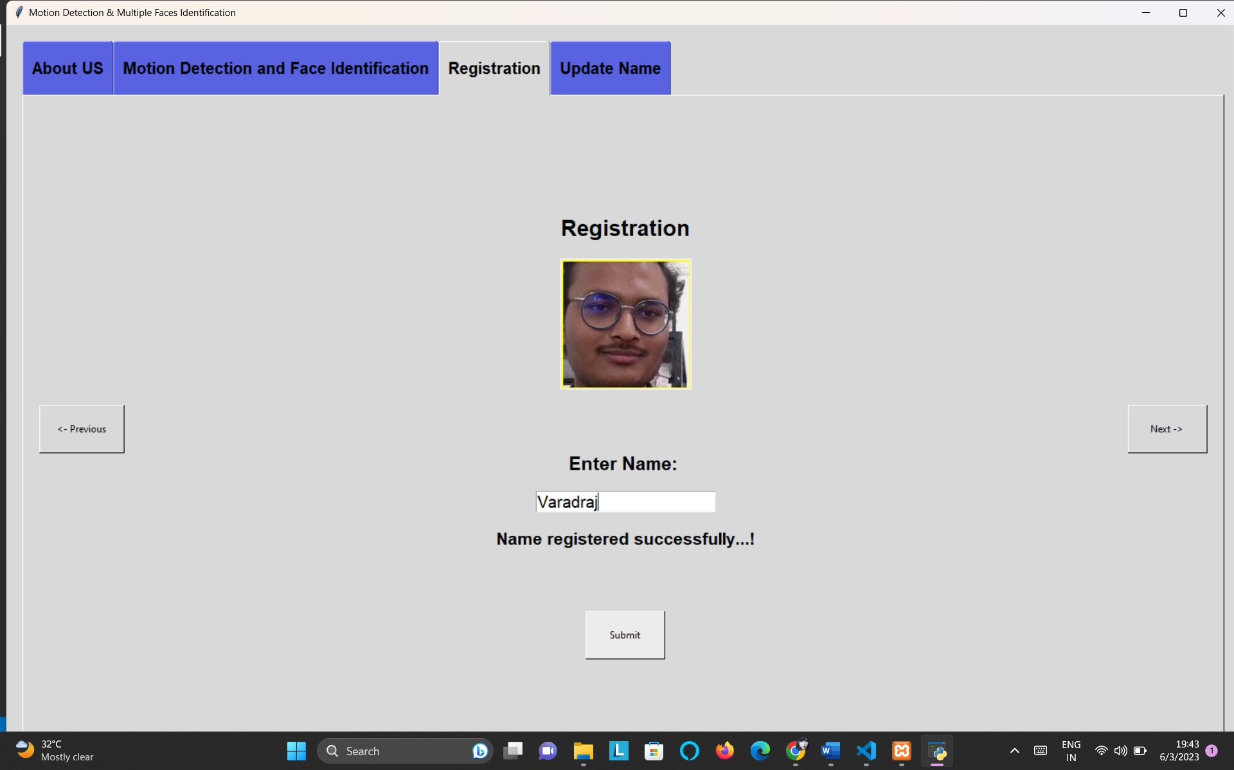
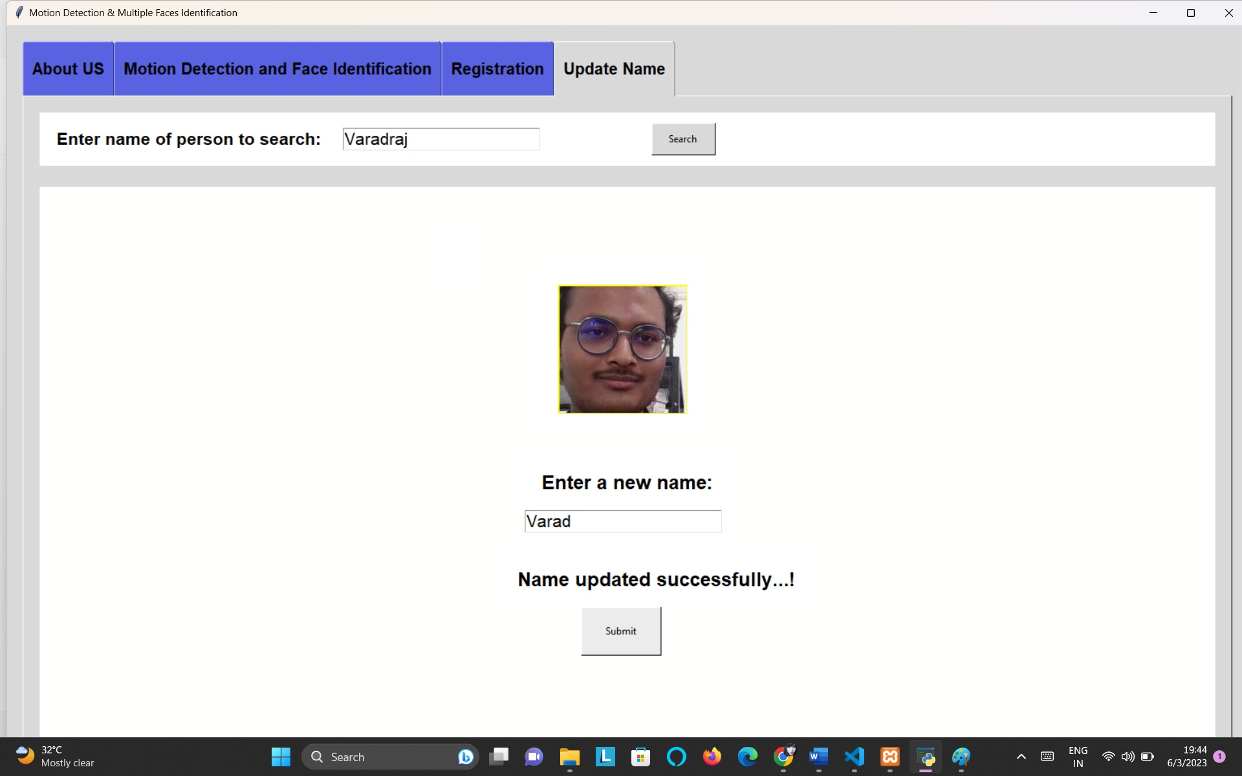
Result (Cont.)
Also, we provide the User Interface (in Figure aside) so that users can add newly detected face in database and also, can update the name of person’s name whose name was entered in a wrong way.
The use of User Interface is to make user interaction with model more easier and understandable.

Slide 15
Test cases: Database
TC_ID | Test Case Objective | Pre-requisites | Steps | Input | Expected Result | Actual Result | Status
TC_01 | To check the database is accessing or not | “imaged” database should be available | Connect to database using MySQL connector | (‘localhost”,”root”, “”, “ImageDB”) | Database must be accessed | Database connection accessed | Pass
TC_02 | Inserting data into unknown table | Unknown table should be available | Add face encodings and image file name into unknown table | (face_enc, Img_name) | Data must be inserted | Data inserted successfully | Pass
TC_03 | Fetching data from unknown table | Unknown table should be available | Fetch data from unknown table using MySQL DML select query | Select face_enc and name from unknown | Data should be fetched | Data fetched successfully | Pass
TC_04 | Inserting data into known table | Known table should be available | Add face encoding from unknown table and person’s name | (face_enc, name) | Data must be inserted | Data insert successfully | Pass
TC_05 | After successfully insertion of data in known table data from unknown table should be deleted | Known and unknown table should be available | Delete data from unknown table after successful insertion of data from unknown to known table | Delete all from unknown where img_name = current_img_name | Data should be deleted | Data deleted successful | Pass
TC_06 | Fetching data from known table | Known table should be available | Fetch data from known table using MySQL DML select query | Select face_enc and person’s name from known | Data should be fetched | Data fetched successfully | Pass

Slide 16
Test caese: webcam
TC_ID | Test Case Objective | Pre-requisites | Steps | Input | Expected Result | Actual Result | Status
TC_01 | On start of the model the Webcam should be accessed | System’s Webcam should be available | Access the system Webcam when model start | NA | System’s Webcam must be accessed | System’s Webcam accessed successfully | Pass
TC_02 | Webcam should capture the live video stream | Webcam should be available and must be accessible | Start live video stream using Webcam | NA | Live video stream should be started | Live video stream had started | Pass
TC_03 | Webcam live video stream should stop on model termination | Webcam should be available and must be accessible | Stop live video stream on model termination | NA | Live video stream should be stop on model termination | Live video stream had stopped | Pass

Slide 17
Test cases: model
TC_ID | Test Case Objective | Pre-requisites | Steps | Input | Expected Result | Actual Result | Status
TC_01 | Model should be started | Model must be available with code | Start model | NA | Model should be start | Model had started | Pass
TC_02 | Fetch data from known and unknown tables | Known and Unknown table should be available in ImageDB database | Fetch data from known and unknown table and store in local variables | MySQL DML select query for fetching data from tables | Data should be fetched | Data fetched successfully | Pass
TC_03 | Start live video stream using System’s Webcam | System’s Webcam should be available and must be accessible | Start live video stream using Webcam | NA | Live video stream should start | Live video stream had started | Pass
TC_04 | Access video stream into frame | System’s Webcam should be available and must be accessible | Accept frames of live video stream | Webcam’s live video stream | Frames should be accepted using live video stream | Frames was accepted using live video stream | Pass
TC_05 | Convert RGB frames into grey level frames | Frames should be available | Conversion of frames from RGB color to grey scale level color | RGB frames | Conversion should be done | Conversion done successfully | Pass
TC_06 | Start detecting the Motion from Grey level frames | Grey level frame should be available | Start detecting motion using grey level converted frames | Grey Level frames | Motion should be detected | Motion is detected | Pass
TC_07 | Start Haar-Cascade Model | Haar-Cascade model should be available | Start the Haar-Cascade model for detecting faces | Live video stream from Webcam | Haar-Cascade Classifier model should be started | Haar-Cascade Classifier had started | Pass

Slide 18
Test cases: model (cont.)
TC_ID | Test Case Objective | Pre-requisites | Steps | Input | Expected Result | Actual Result | Status
TC_08 | Start detecting the multiple faces using Haar-Cascade Model | Haar-Cascade model should be started | Start detecting multiple faces | Harr-Cascade model and live video stream from Webcam | Multiple faces must be detected | Multiple faces are detected | Pass
TC_09 | Store the newly detected face in unknown table and also in local drive | Unknown table and physical drive should be available | Store newly detected face in database and in local storage | Newly detected face from Haar-Cascade Classifier model | Newly detected face must be stored in local storage as well as in unknown table | Newly detected face stored in local storage as well as in unknown table successfully | Pass
TC_10 | Start the Face Recognition model | Face Recognition model should be available | Start the Face Recognition model | Live video stream from Webcam | Face Recognition model should start | Face Recognition model had started | Pass
TC_11 | Access the known face encodings fetched from known table from database | Known face encodings list and known table should be accessed | Access the known face encodings list | Known table face encodings | List of known face encodings should be access | List of known face encodings had accessed | Pass
TC_12 | Start recognition of multiple faces | Known face encodings list, multiple faces detected by Haar-Cascade Classifier and live video stream using Webcam | Start recognizing of multiple faces | Known face encodings list, multiple faces detected by Haar-Cascade Classifier model and Live video stream from Webcam | Multiple Faces Recognition must be done by the model | The model has recognized multiple faces | Pass
TC_13 | Update detected movement time in csv file and terminate model | Time of movement.csv file | Update time of detected movement by Gaussian-Blur method | Start and end time of movement | Time of detected movement should be updated and model has Terminated too. | Time of movement detected by Gaussian-Blur model has updated and Model has terminated too. | Pass

Slide 19
Test cases: model (cont.)
TC_ID | Test Case Objective | Pre-requisites | Steps | Input | Expected Result | Actual Result | Status
TC_14 | Add the newly Detected face | Newly detected face file, textbox to entry name should be available | Add name to newly detected face | Enter name in textbox | Name of newly detected face should be entered | Name of newly detected face had entered | Pass
TC_15 | Check whether the enter name is present in database | Known table should be available | Check whether name is duplicate | Name entered in textbox | If available show message “Name already present in database. Enter their name with surname or nickname” | Message shown as “name already present in database. Enter their name with surname or nickname” | Pass
TC_16 | Register name with face encodings in known table if name is unique and show message | Known table, face encodings of newly detected face from unknown table and message label | Registered name with face encodings in the known table | Newly detected face encodings from unknown table and unique name | Insert newly detected face encodings with their name and show message “Name registered successfully” | Newly detected face encodings with their name registered and message shown as “Name registered successfully” | Pass
TC_17 | Enter name to search in database for updating name | Name textbox to search name in table and known table | Enter name to search in the known table | Person’s name | Person’s name should be entered | Person’s name has entered | Pass
TC_18 | is name not present in database then show message | Message label, person’s name and known table | Check whether name is present in database | Person’s name | If not available show message “Name not present in database. Enter a valid name” | Message shown as “Name not present in database. Enter a valid name” for invalid name | Pass

Slide 20
Test cases: model (cont.)
TC_ID | Test Case Objective | Pre-requisites | Steps | Input | Expected Result | Actual Result | Status
TC_19 | If present show the face to enter the updated name | Face label and new name textbox | Show face of search name to update his/her name | Person’s name | Name present in database and accept the new update name of person | Updated name of person has accepted by the model | Pass
TC_20 | Check whether name is present in database and show message | Known table, message label and person’s updated name | Check whether name is duplicate | Person’s updated name | If present then show message “Name already present in database. Enter their name with surname or nickname” | Message shown for present name in database as “Name already present in database. Enter their name with surname or nickname” | Pass
TC_21 | If not update name in database and show message | Known table, message label and person’s updated name | Update person’s unique name in known table | Person’s updated name | Update person’s new name using MySQL DML update query and show message as “Name updated successfully” | Message shown as “Name updated successfully” for uniquely updated person’s name | Pass

Slide 21
Applications
Smart Automation: Motion detection and multiple faces identification can be integrated into various automation systems, such as smart homes and offices. By automatically detecting motion, these technologies can trigger specific actions, such as turning on lights, adjusting temperature, or activating security alarms, enhancing convenience and energy efficiency.
Personalized Experiences: Multiple faces identification can be used to provide personalized experiences in various settings. For instance, in retail environments, it can enable targeted advertisements or personalized greetings for frequent customers, enhancing customer satisfaction and engagement.
Optimized Resource Allocation: Motion detection helps optimize the allocation of resources in various sectors. For example, in traffic management, it can identify congested areas, allowing authorities to deploy resources efficiently and improve traffic flow.
Emergency Response: Motion detection and multiple faces identification can aid emergency response systems. By quickly identifying the presence of individuals in distress or danger, these technologies can trigger alerts and ensure prompt assistance, potentially saving lives.

Slide 22
Applications (cont.)
Enhanced User Interfaces: These technologies can contribute to the development of intuitive user interfaces. For instance, in gaming or virtual reality applications, motion detection enables more immersive and interactive experiences, improving user satisfaction and engagement.
Medical and Healthcare Applications: Motion detection and multiple faces identification can be used in medical and healthcare settings. These technologies can assist in patient monitoring, fall detection for the elderly, and tracking movements for rehabilitation purposes, leading to improved healthcare outcomes.
Advancements in Artificial Intelligence: The development and deployment of motion detection and multiple faces identification technologies drive advancements in Artificial Intelligence and Computer Vision. These advancements have a broader impact on various industries, pushing the boundaries of what is possible and opening up new opportunities for innovation

Slide 23
Conclusion
According to the results, we conclude that the Gaussian-Blur, Haar-Cascade Classifier and Face Recognition model helps to build the entire project effectively.
The model detects and recognizes multiple faces simultaneously by using the Webcam of the computer. This project successfully shows how the model helps to capture the multiple faces, their detection and verification using the Haar-Cascade features and Face Recognitions Module. All the detection and recognition are done by the system with much fewer human interfaces, which makes this system automated and can give more advanced security.
Even when detecting multiple faces, the model also detects the motion of the objects and alerts the system about the movements captured by the Web Camera which will be much more helpful for providing advanced security to an organization or to a home.

Slide 24
Future Scope
This model can be used in “Mental Hospital” for keeping track of mentally-ill patients, and keeping their facial data in the database to track them even into a crowded area using the security or web camera.
It also helps in keeping the facial data of the people which helps an organizations to avoid cases of frauds.
This model can also be used in the Airline Industry for keeping track of bags, people and boarding people. By using the recognition model, we can recognize the people at the check-in, which will help speed up the check-in process while ensuring security protocols and measures are followed, and also make the duties easier for the security personnel and airline staff.
We can use more advanced camera for getting more accurate results.

Slide 25
references
[1] M. Khan, S. Chakraborty, R. Astya And S. Khepra, "Face Detection And Recognition Using Opencv," 2019 International Conference On Computing, Communication, And Intelligent Systems (ICCCIS), Greater Noida, India, 2019, Pp. 116-119, Doi: 10.1109/Icccis48478.2019.8974493.
[2] Shubham Mishra, Mrs. Versha Verma, Dr. Nikhat Akhtar, Shivam Chaturvedi, Dr. Yusuf Perwej, " An Intelligent Motion Detection Using Opencv, International Journal Of Scientific Research In Science, Engineering And Technology (IJSRSET), Print ISSN : 2395-1990, Online ISSN : 2394-4099, Volume 9, Issue 2, Pp.51-63, March-april-2022.
[3] N. Pooja, B. S. Bhaskar, J. Aman, And C. Sarika, “Motion Detection Of Webcam Using Frame Differencing Method,” Research Journal Of Engineering And Technology, Vol. 12, No. 2, Pp. 32–38, 2021.
[4] Ankita Rameshwar Mahajan And Vinod Agrawal, "Movement Detection Using Opencv", International Research Journal Of Modernization In Engineering Technology And Science, Vol. 04, No. 05, 2022.
[5] C. Y. Yong, R. Sudirman And K. M. Chew, "Motion Detection And Analysis With Four Different Detectors," 2011 Third International Conference On Computational Intelligence, Modelling & Simulation, Langkawi, Malaysia, 2011, Pp. 46-50, Doi: 10.1109/Cimsim.2011.18.
[6] Gaussian-blur: https://www.tutorialspoint.com/opencv/opencv_gaussian_blur.htm
[7] Opencv Haar-cascade Classifier: https://docs.opencv.org/3.4/d2/d99/tutorial_js_face_detection.html

Slide 26
Thank you..

